Slide 1
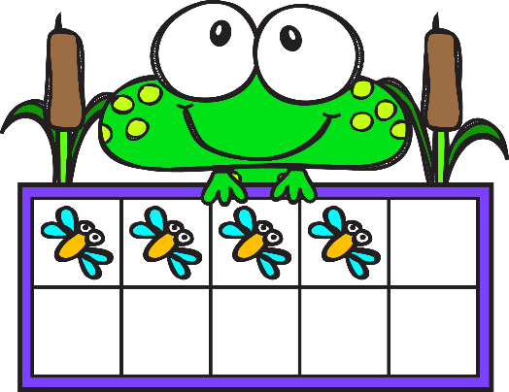
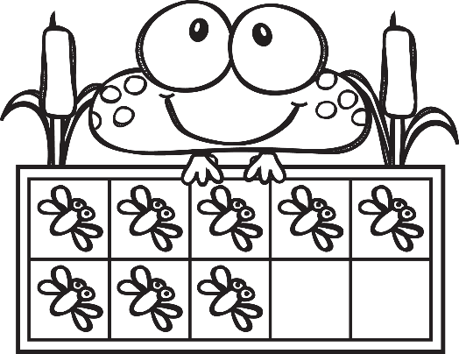
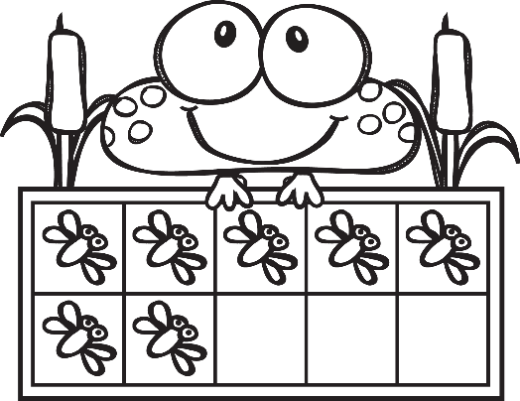
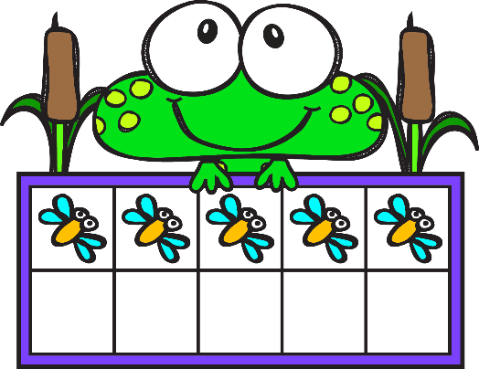
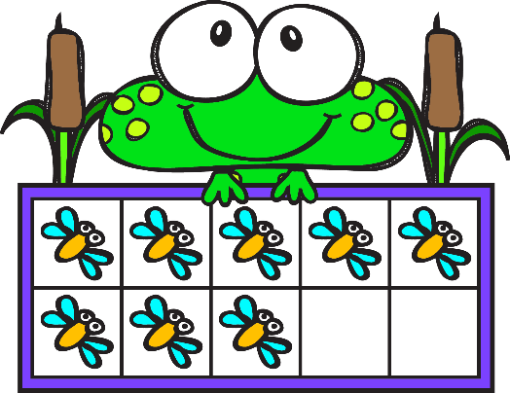
Counting Flies
Counting objects 1-10
Differentiated worksheets
for all ability levels!
Lower level – Count and circle the correct number of objects.
Higher level – Count and write the correct number of objects.
This is a FREE sample version. Full version available!
Full color AND B & W versions!

Slide 2
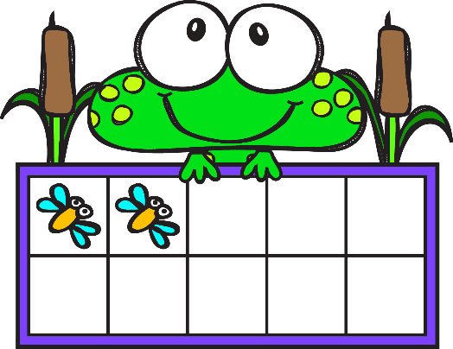
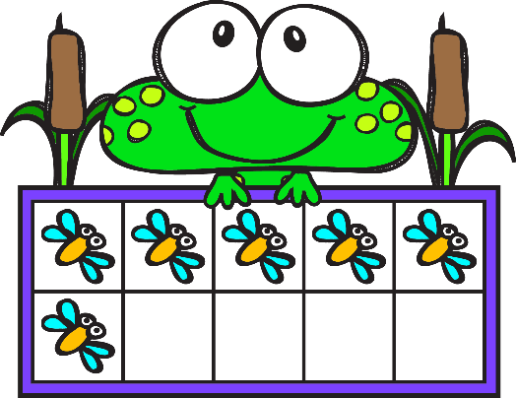
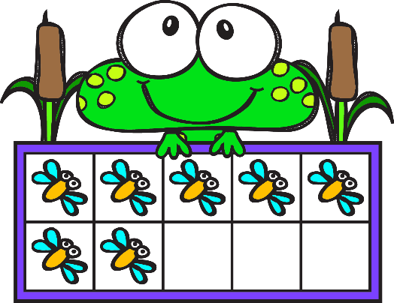
Counting Flies Name _______________
7 | 4 | 2
1 | 6 | 2
6 | 5 | 3
3 | 5 | 8
4 | 7 | 6
5 | 3 | 4
2 | 1 | 0
3 | 7 | 8

Slide 3
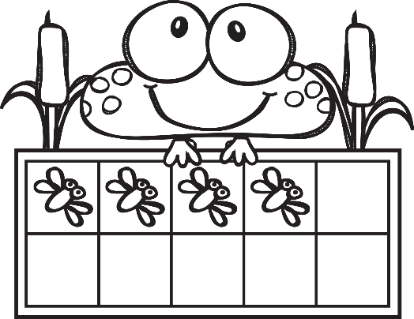
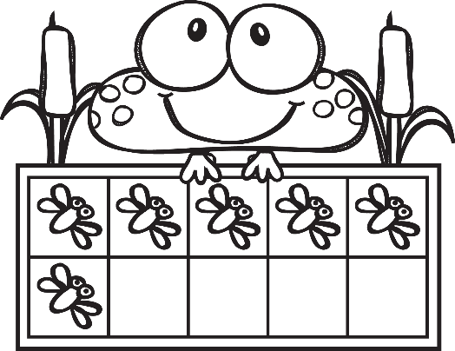
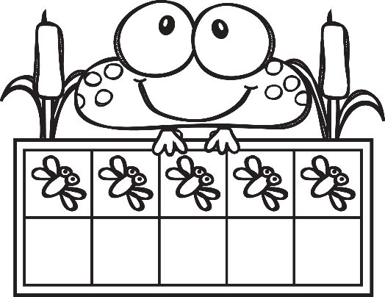
Counting Flies Name _______________
7 | 4 | 2
1 | 6 | 2
6 | 5 | 3
3 | 5 | 8
4 | 7 | 6
5 | 3 | 4
2 | 1 | 0
3 | 7 | 8

Slide 4
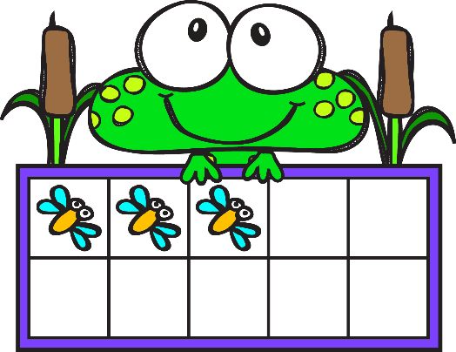
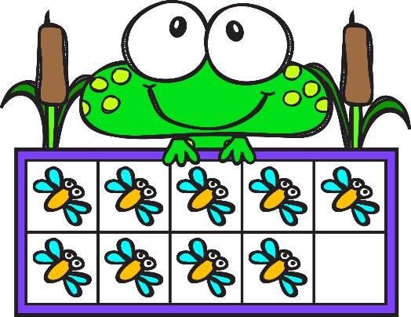
Counting Flies Name _______________

Slide 5
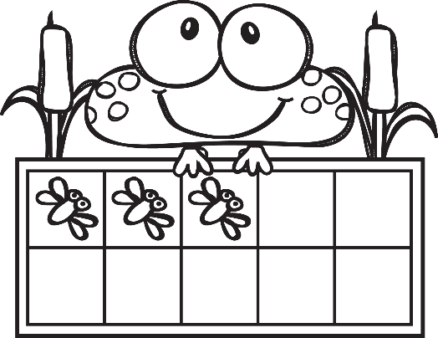
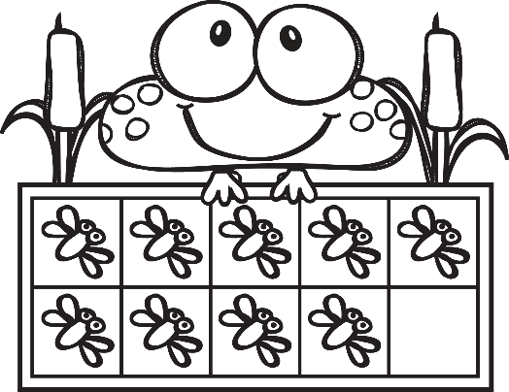
Counting Flies Name _______________
3 | 1 | 2
1 | 5 | 4
6 | 2 | 5
8 | 6 | 4
4 | 9 | 7
5 | 6 | 8
2 | 1 | 0
4 | 3 | 6

Slide 6
Thank you so much for downloading my product. If you like what you see, you can purchase more of my worksheets on TpT. If you have any questions, comments, or concerns, please feel free to let me know at transitiontownUSA@gmail.com. I want to make you happy!
Terms of Use: ©TransitionTown,USA2019, Amy Merrick. All rights reserved. This product is to be used by the original downloader only for use in a single classroom. Copying for more than one teacher, classroom, department, school, or district is strictly prohibited. This resource file is not to be posted or shared on any digital or social media outlet without express written permission.
The following were used in the creation of these worksheets. A special thanks go to them for their talented resources!

